Slide 1
“BRAINSTORMING FOR AN ESSAY”
English Composition
Department of Computer Science

Slide 2
Brainstorming
What is it?
A gathering of ideas from your brain onto paper.
The variety of ideas and the use of your imagination assist you in producing a lot of material with which to work.
Why do we need it?
It’s the best way to collect your thoughts.
It’s helpful for organization.
It ensures only quality ideas are used in the essay.

Slide 3
Brainstorming Technique
Number One
Free writing
What is it?
Think about the topic. Then write, write, write. Whatever comes into your brain – even if it doesn’t have to do with the topic. Example:
"This paper is supposed to be on the politics of tobacco production but even though I went to all the lectures and read the book I can't think of what to say and I've felt this way for four minutes now and I have 11 minutes left and I wonder if I'll keep thinking nothing during every minute but I'm not sure if it matters that I am babbling and I don't know what else to say about this topic and it is rainy today and I never noticed the number of cracks in that wall before and those cracks remind me of the walls in my grandfather's study and he smoked and he farmed and I wonder why he didn't farm tobacco..."

Slide 4


Brainstorming Technique
Number One
Freewriting
Options:
Write for a specific time period
Write for a specific amount of paper

Slide 5
Brainstorming Technique
Number One
Freewriting
When is it helpful?
When you have NO ideas about a topic
When you have TOO MANY ideas about a topic

Slide 6

Brainstorming Technique
Number Two
Making a Cube
What is it?
Imagine a cube. It has six sides. On each side, you have a different task regarding the topic.

Slide 7
Brainstorming Technique
Number Two
Making a Cube
Side One: Describe the topic.
Describe
Compare
Associate
Analyze
Apply
Argue
Side Two: Compare the topic.
Side Three: Associate the topic.
Side Four: Analyze the topic.
Side Five: Apply the topic.
Side Six: Argue for or against the topic.

Slide 8
Brainstorming Technique
Number Three
Clustering
What is it?
When you write down words or concepts associated with the topic – any ideas that come into your mind

Slide 9
Brainstorming Technique
Number Three
Global Warming
rainforests disappearing
extinction ^{emissions} dangerous
_{dying animals} toxic world wide
Cars/SUVs factories
landscape changes no icebergs
expensive to fix? hurricanes
Reversible?
Clustering
Draw a bubble.
And write the topic above it.
Brainstorm!
Now look for words that connect with each other. Circle the words and connect them with lines.

Slide 10
Brainstorming Technique
Number Four
Listing or Bulleting
What is it?
Create a list of terms/ideas/concepts about the topic. Create multiple lists depending on the purpose.
Global Warming
Toxic fumes
SUVs/Cars
Extinction
Belief/Disbelief
Kyoto Agreement
Belief/Disbelief
Scientists disagree
Average American
China/USA
Normal occurrence or abnormal event?

Slide 11
Brainstorming Technique
Number Five
Paris, France
Paris, Texas
Venn Diagram
Capital
Became Paris in 400 A.D.
francophone
Cities
Eiffel Tower
County seat
Anglophone
Founded in 1839
What is it?
Draw two circles that connect, like this:
List two topics above the circles.
Brainstorm about the topics – what do they have in common and what is unique about each one.

Slide 12
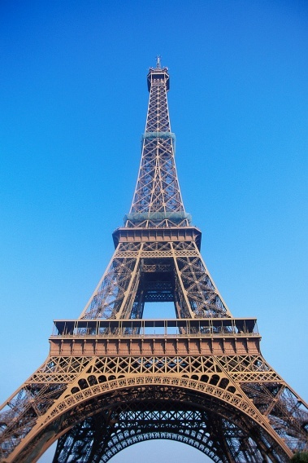
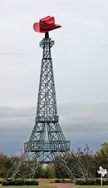
Brainstorming Technique
Number Five
Venn Diagram
When is it used?
When you are writing a comparison or contrast essay.
Paris, France
Paris, Texas
Capital
Became Paris in 400 A.D.
francophone
Cities
Eiffel Tower
County seat
anglophone
Founded in 1839

Slide 13
Brainstorming Technique
Number Six
Tree Diagram
What is it?
This diagram has a central idea to which you add branches that focus on details.

Slide 14
Brainstorming Technique
Number Six
Tree Diagram
When do you use it?
This type of diagram is helpful in classification essays.
Media
Print
Visual
Audio
Newspaper magazine booklet
television webpage movie
cd mp3 cassette

Slide 15

Brainstorming Technique
Number Seven
Act like a Journalist
What is it?
Using the question words in English to explore the topic.
Who?
Why?
Where?
When?
What?
How?

Slide 16
Brainstorming Technique
Number Seven
Act like a Journalist
When is it useful?
Use this technique when you want to write a narrative.
Why?
Who?
Where?
When?
What?
How?

Slide 17
Brainstorming Technique
Number Eight
T-Diagram
What is it?
Using a T shape, list a category that you want to compare or contrast about a specific topic or topics. Do this for a variety of categories.
Paris, France and Paris Texas
location
Europe
Northern France
North America
Northern Texas

Slide 18
Brainstorming Technique
Number Eight
T-Diagram
When is it useful?
This technique helps when you are writing a contrast or comparison essay.
Paris, France and Paris Texas
location
Europe
Northern France
North America
Northern Texas

Slide 19
Brainstorming Technique
Number Nine
Spoke Diagram
What is it?
Write the topic in a circle. Then think of about causes and effects. Write these around the circle like spokes on a wheel.
too many people
cars/suvs not recycling chopping down trees
Global Warming
Crazy weather
loss of polar ice caps
dying animals

Slide 20
Brainstorming Technique
Number Nine
Spoke Diagram
When is it useful?
Use this technique when you want to explore cause and effect.
too many people
cars/suvs not recycling chopping down trees
Global Warming
Crazy weather
loss of polar ice caps
dying animals

